Slide 1
Introduction to Differential Equations - Lecture 5
Fei Qi
Email: fei.qi@du.edu
Office Hour: TBA
Website: https://feiqimath.github.io

Slide 2

Existence and uniqueness theorem: linear version
Theorem: Consider the IVP
$$y^{′}+p\left(t\right)y=g\left(t\right), y\left(t_{0}\right)=y_{0}$$
If both $p(t)$ and $g(t)$ are continuous on $(a, b)$ that contains $t_{0}$. Then on the interval $(a, b)$, the IVP has a unique solution.
Remark: Recall in Lecture 3 Example 7, we studied the IVP
$$y^{′}+y=g\left(t\right),y\left(0\right)=0,g\left(t\right)=\left\{\begin{aligned}1 0≤t≤1 \\ 0 t>1\end{aligned}\right.$$
Since $g\left(t\right)$ is not continuous at 1, the IVP only has a unique solution on [0, 1]. Indeed, for every number $C$,
$$y\left(t\right)=\left\{\begin{aligned}1−e^{−t} t∈[0,1] \\ {Ce}^{−t} t∈(1,∞)\end{aligned}\right.$$
is a solution (the IVP has infinitely many solutions).

Slide 3









Existence and uniqueness theorem: nonlinear case
Theorem: Consider the IVP
$$y^{′}=f\left(t,y\right), y\left(t_{0}\right)=y_{0}.$$
Assume that
The function $f(t,y)$ is continuous NEAR $\left(t_{0},y_{0}\right)$, i.e., one can find small $ε_{1},ε_{2}>0$, such that $f(t,y)$ is continuous in the rectangular region $\left(t_{0}−ε_{1},t_{0}+ε_{1}\right)×\left(y_{0}−ε_{2},y_{0}+ε_{2}\right).$
The function $\frac{∂f}{∂y}(t,y)$ is continuous NEAR $(t_{0},y_{0})$.
Then a unique solution $y=y\left(t\right)$ exists NEAR $t=t_{0}$, i.e., there exists a small $ε>0$ such that a solution exists on $\left(t_{0}−ε,t_{0}+ε\right)$.
$$y_{0}+ε_{2}$$
$$y_{0}$$
$$y_{0}−ε_{2}$$
$$t_{0}$$
$$t_{0}−ε_{1}$$
$$t_{0}+ε_{1}$$
$$t_{0}−ε$$
$$t_{0}+ε$$

Slide 4
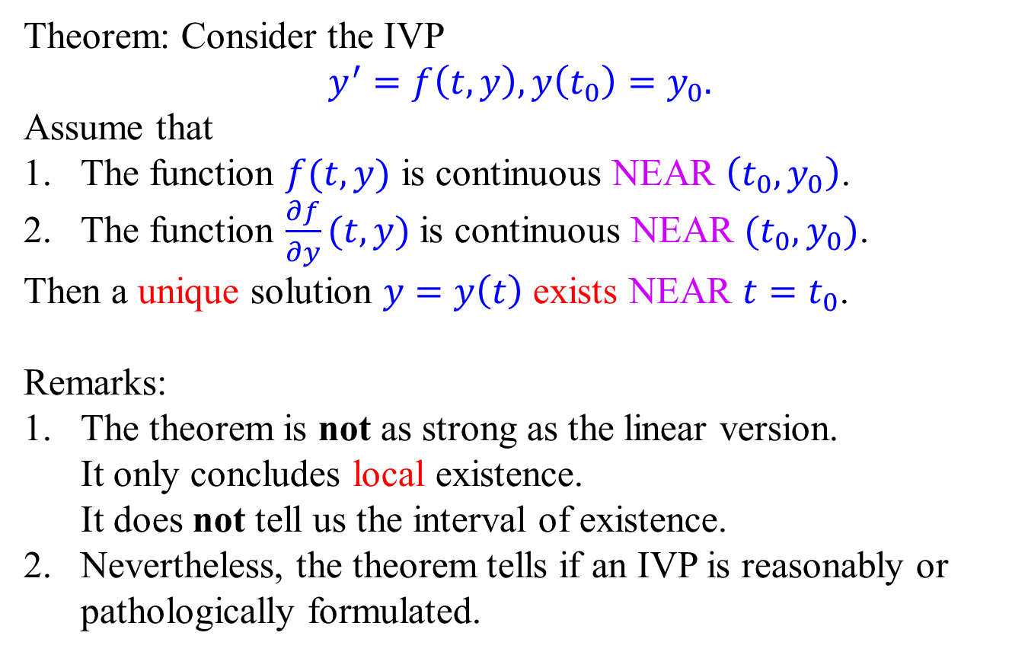
Existence and uniqueness theorem: nonlinear case
Theorem: Consider the IVP
$$y^{′}=f\left(t,y\right), y\left(t_{0}\right)=y_{0}.$$
Assume that
The function $f(t,y)$ is continuous NEAR $\left(t_{0},y_{0}\right)$.
The function $\frac{∂f}{∂y}(t,y)$ is continuous NEAR $(t_{0},y_{0})$.
Then a unique solution $y=y\left(t\right)$ exists NEAR $t=t_{0}$.
Remarks:
The theorem is not as strong as the linear version. It only concludes local existence. It does not tell us the interval of existence.
Nevertheless, the theorem tells if an IVP is reasonably or pathologically formulated.

Slide 5
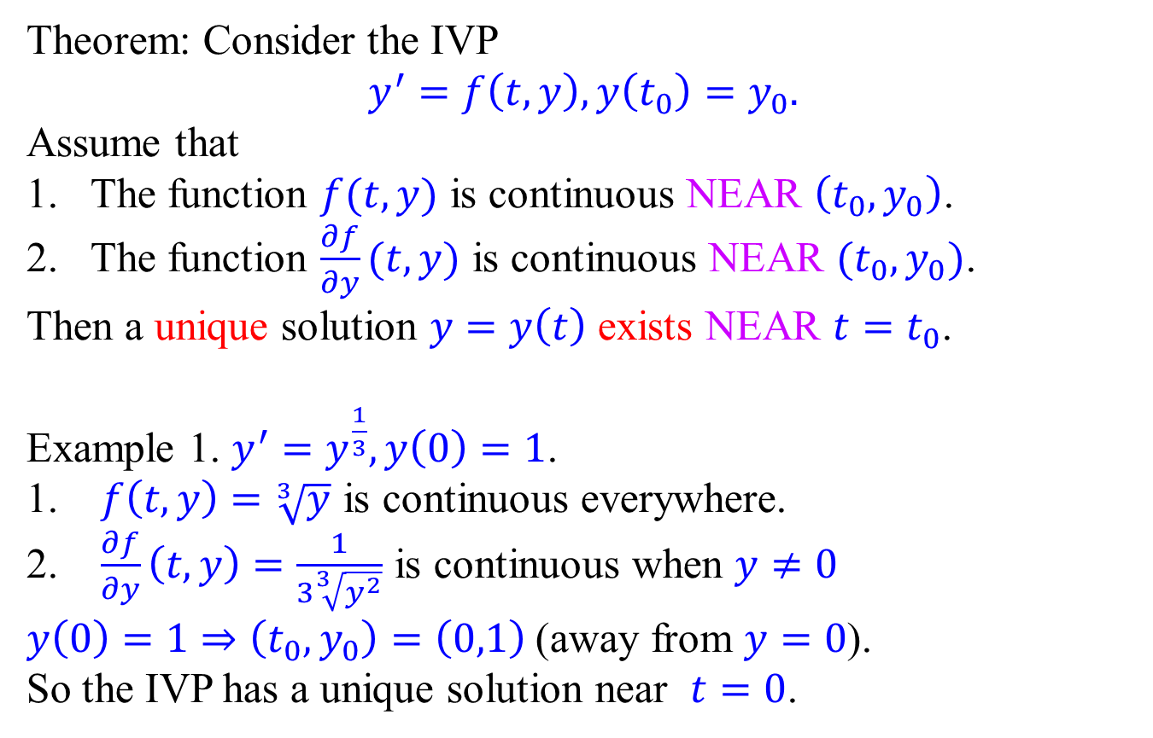
Existence and uniqueness theorem: nonlinear case
Theorem: Consider the IVP
$$y^{′}=f\left(t,y\right), y\left(t_{0}\right)=y_{0}.$$
Assume that
The function $f(t,y)$ is continuous NEAR $\left(t_{0},y_{0}\right)$.
The function $\frac{∂f}{∂y}(t,y)$ is continuous NEAR $(t_{0},y_{0})$.
Then a unique solution $y=y\left(t\right)$ exists NEAR $t=t_{0}$.
Example 1. $y^{′}=y^{\frac{1}{3}}, y\left(0\right)=1$.
$f\left(t,y\right)=\sqrt[3]{y}$ is continuous everywhere.
$\frac{∂f}{∂y}\left(t,y\right)=\frac{1}{3\sqrt[3]{y^{2}}}$ is continuous when $y≠0$
$y\left(0\right)=1⇒\left(t_{0},y_{0}\right)=\left(0,1\right)$ (away from $y=0$).
So the IVP has a unique solution near $t=0$.
(0,1)

Slide 6
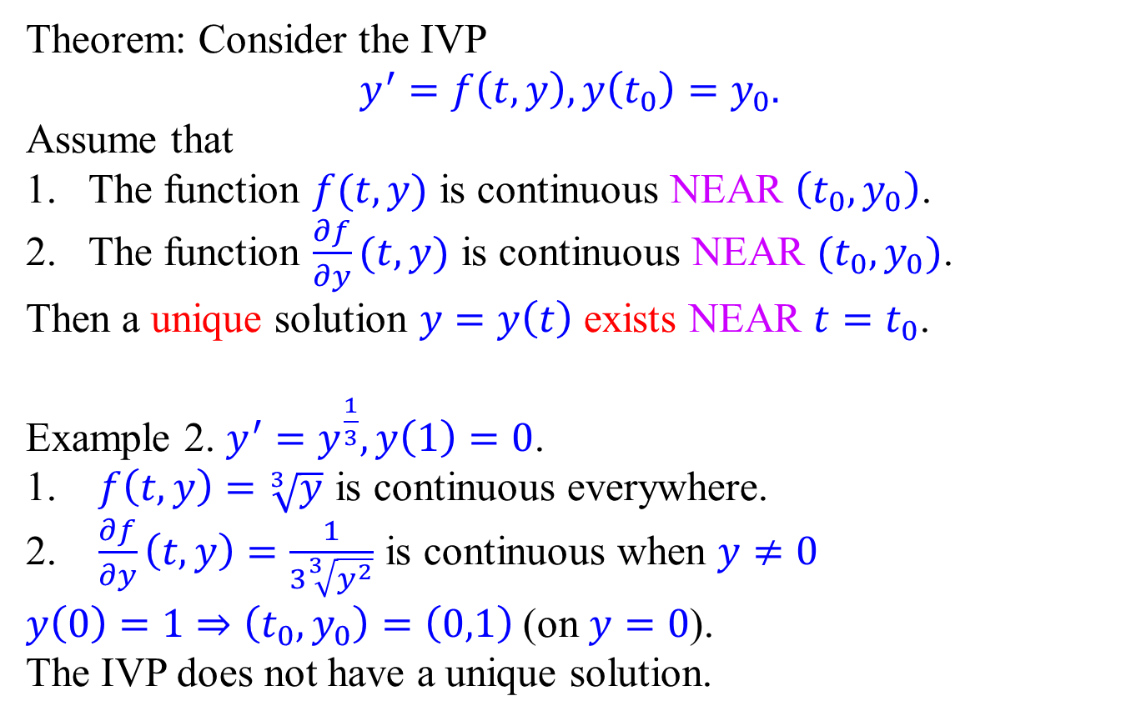
Existence and uniqueness theorem: nonlinear case
Theorem: Consider the IVP
$$y^{′}=f\left(t,y\right), y\left(t_{0}\right)=y_{0}.$$
Assume that
The function $f(t,y)$ is continuous NEAR $\left(t_{0},y_{0}\right)$.
The function $\frac{∂f}{∂y}(t,y)$ is continuous NEAR $(t_{0},y_{0})$.
Then a unique solution $y=y\left(t\right)$ exists NEAR $t=t_{0}$.
Example 2. $y^{′}=y^{\frac{1}{3}}, y\left(1\right)=0$.
$f\left(t,y\right)=\sqrt[3]{y}$ is continuous everywhere.
$\frac{∂f}{∂y}\left(t,y\right)=\frac{1}{3\sqrt[3]{y^{2}}}$ is continuous when $y≠0$
$y\left(0\right)=1⇒\left(t_{0},y_{0}\right)=\left(0,1\right)$ (on $y=0$).
The IVP does not have a unique solution.
(1,0)

Slide 7
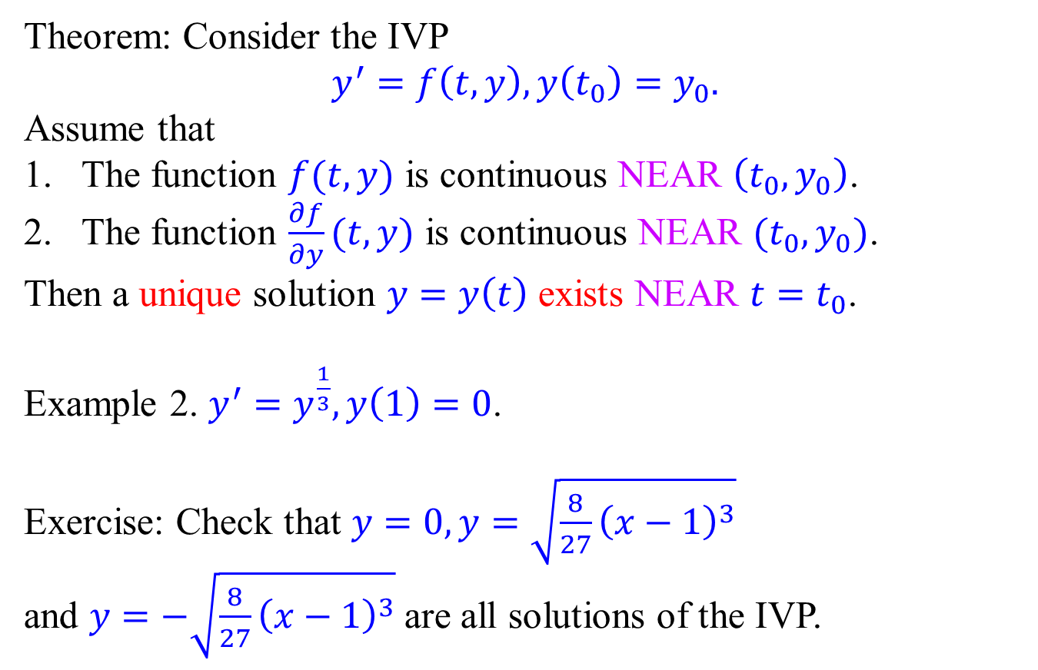
Existence and uniqueness theorem: nonlinear case
Theorem: Consider the IVP
$$y^{′}=f\left(t,y\right), y\left(t_{0}\right)=y_{0}.$$
Assume that
The function $f(t,y)$ is continuous NEAR $\left(t_{0},y_{0}\right)$.
The function $\frac{∂f}{∂y}(t,y)$ is continuous NEAR $(t_{0},y_{0})$.
Then a unique solution $y=y\left(t\right)$ exists NEAR $t=t_{0}$.
Example 2. $y^{′}=y^{\frac{1}{3}}, y\left(1\right)=0$.
Exercise: Check that $y=0, y=\sqrt{\frac{8}{27}{\left(x−1\right)}^{3}}$
and $y=−\sqrt{\frac{8}{27}{\left(x−1\right)}^{3}}$are all solutions of the IVP.
(1,0)

Slide 8
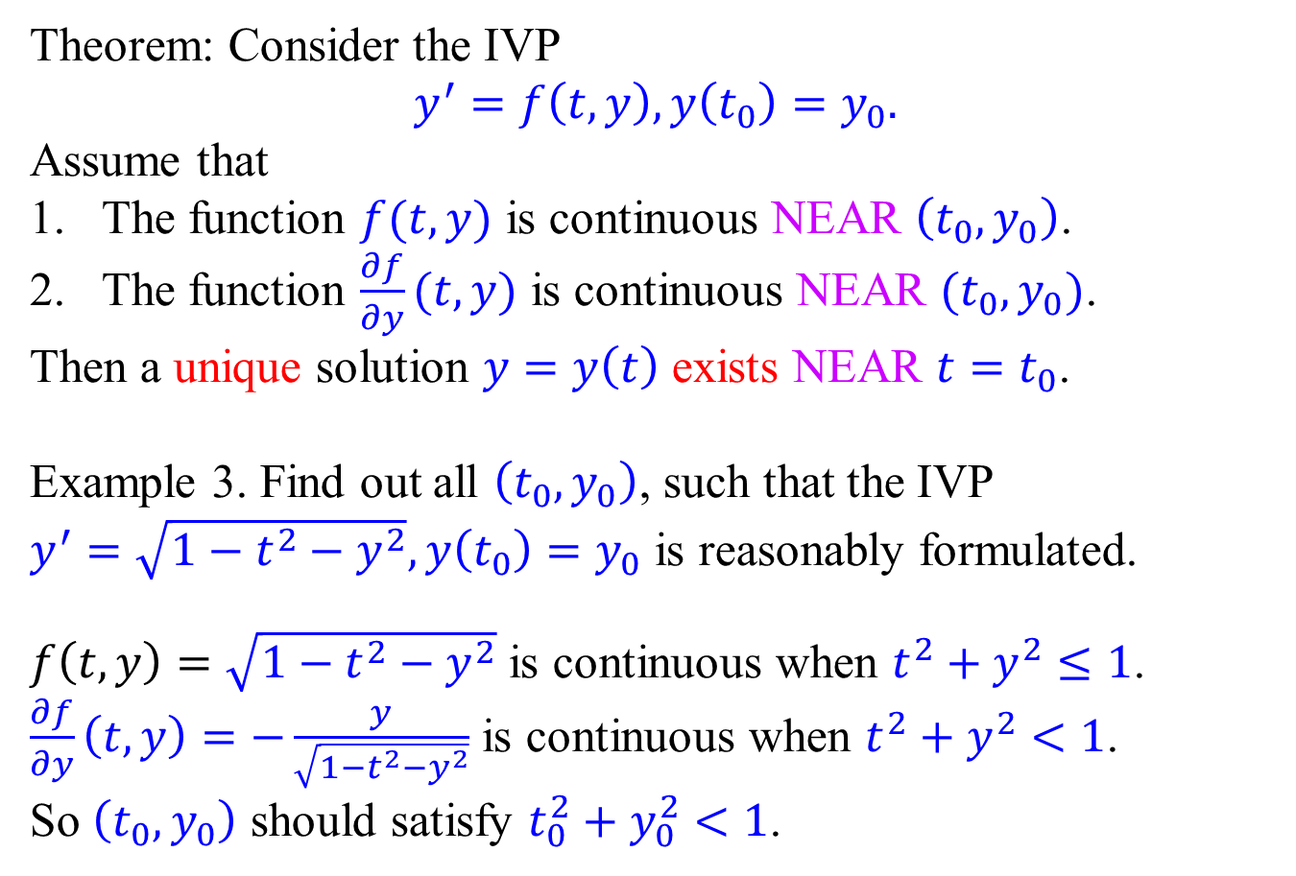
Existence and uniqueness theorem: nonlinear case
Theorem: Consider the IVP
$$y^{′}=f\left(t,y\right), y\left(t_{0}\right)=y_{0}.$$
Assume that
The function $f(t,y)$ is continuous NEAR $\left(t_{0},y_{0}\right)$.
The function $\frac{∂f}{∂y}(t,y)$ is continuous NEAR $(t_{0},y_{0})$.
Then a unique solution $y=y\left(t\right)$ exists NEAR $t=t_{0}$.
Example 3. Find out all $\left(t_{0},y_{0}\right)$, such that the IVP $y^{′}=\sqrt{1−t^{2}−y^{2}},y\left(t_{0}\right)=y_{0}$ is reasonably formulated.
$f\left(t,y\right)=\sqrt{1−t^{2}−y^{2}}$ is continuous when $t^{2}+y^{2}≤1$.
$\frac{∂f}{∂y}\left(t,y\right)=−\frac{y}{\sqrt{1−t^{2}−y^{2}}}$ is continuous when $t^{2}+y^{2}<1$.
So $\left(t_{0},y_{0}\right)$ should satisfy $t_{0}^{2}+y_{0}^{2}<1$.

Slide 9
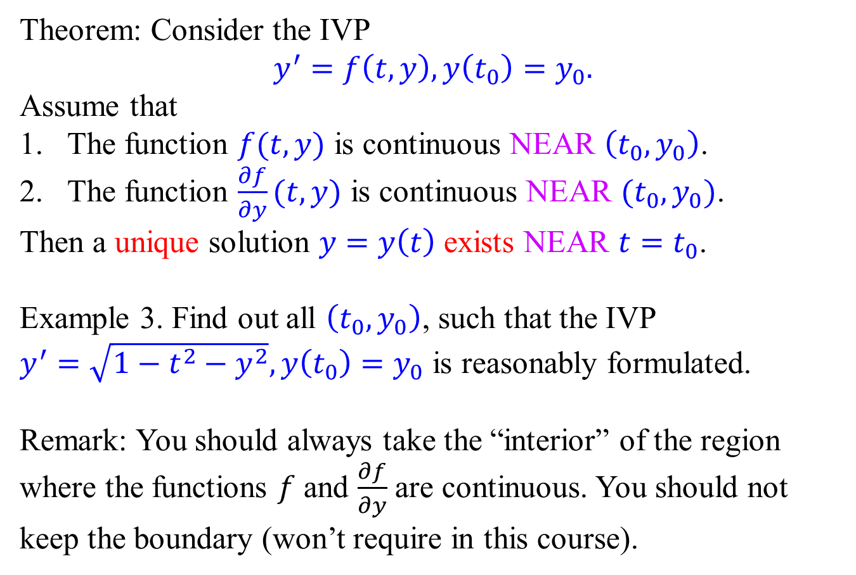
Existence and uniqueness theorem: nonlinear case
Theorem: Consider the IVP
$$y^{′}=f\left(t,y\right), y\left(t_{0}\right)=y_{0}.$$
Assume that
The function $f(t,y)$ is continuous NEAR $\left(t_{0},y_{0}\right)$.
The function $\frac{∂f}{∂y}(t,y)$ is continuous NEAR $(t_{0},y_{0})$.
Then a unique solution $y=y\left(t\right)$ exists NEAR $t=t_{0}$.
Example 3. Find out all $\left(t_{0},y_{0}\right)$, such that the IVP $y^{′}=\sqrt{1−t^{2}−y^{2}},y\left(t_{0}\right)=y_{0}$ is reasonably formulated.
Remark: You should always take the “interior” of the region where the functions $f$ and $\frac{∂f}{∂y}$ are continuous. You should not keep the boundary (won’t require in this course).

Slide 10

Autonomous ODE and equilibrium solution
Autonomous ODE: $y^{′}=f(y)$
(Right-hand-side does not depends on $t$)
Equilibrium Solution: $y=y_{0}$ such that $f\left(y_{0}\right)=0$.
(Left-hand-side = 0 = Right-hand-side)
Example: $y^{′}=\frac{1}{2}y−1$.
$\frac{1}{2}y−1=0⇒y=2$. So $y=2$ is an equilibrium solution.
Example: $y^{′}=\left(y−1\right)y(y+1)$.
$\left(y−1\right)y\left(y+1\right)=0⇒y=0,1,−1$.
So $y=0,y=−1,y=1$ are equilibrium solutions.
Generally, the constant function $y(t)=y_{0}$ is the unique solution of the IVP $y^{′}=f\left(y\right),y\left(t_{0}\right)=y_{0}$.

Slide 11
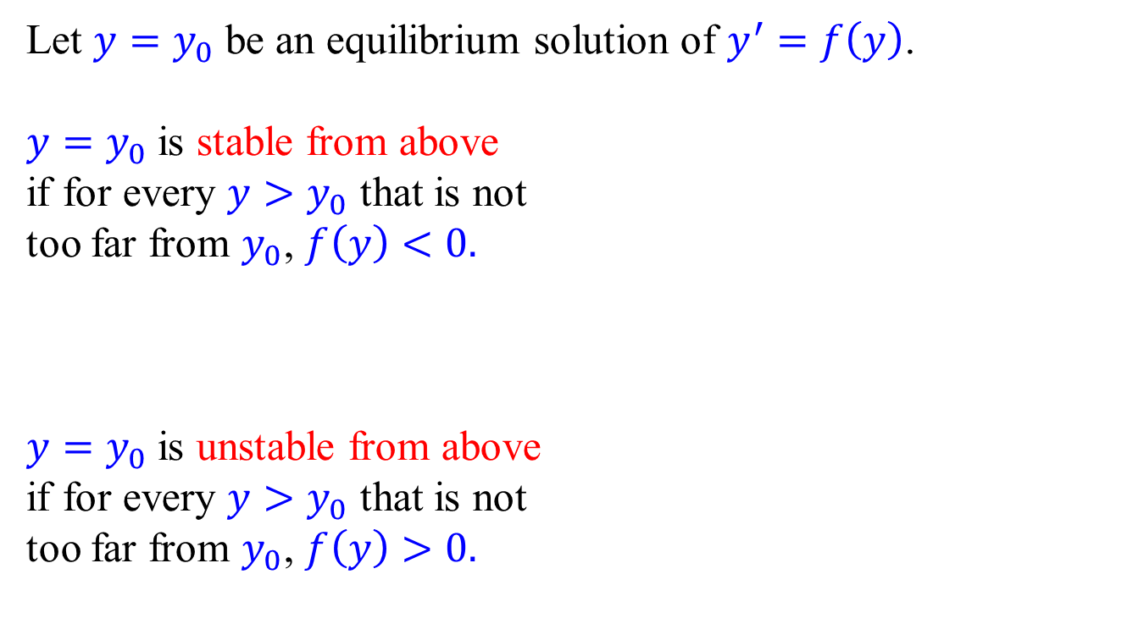


Stability of an equilibrium solution
Let $y=y_{0}$ be an equilibrium solution of $y^{′}=f\left(y\right)$.
$y=y_{0}$ is stable from above if for every $y>y_{0}$ that is not too far from $y_{0}$, $f\left(y\right)<0.$
$y=y_{0}$ is unstable from above if for every $y>y_{0}$ that is not too far from $y_{0}$, $f\left(y\right)>0.$
$y_{0}$
$y_{0}$

Slide 12
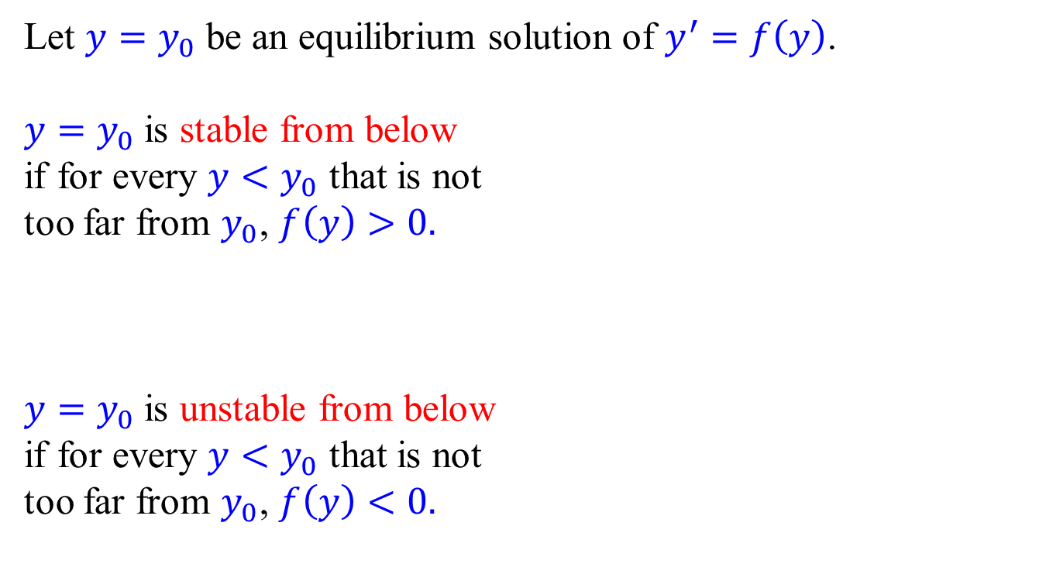
Stability of an equilibrium solution
Let $y=y_{0}$ be an equilibrium solution of $y^{′}=f\left(y\right)$.
$y=y_{0}$ is stable from below if for every $y<y_{0}$ that is not too far from $y_{0}$, $f\left(y\right)>0.$
$y=y_{0}$ is unstable from below if for every $y<y_{0}$ that is not too far from $y_{0}$, $f\left(y\right)<0.$
$y_{0}$
$y_{0}$

Slide 13



Stability of an equilibrium solution
Let $y=y_{0}$ be an equilibrium solution of $y^{′}=f\left(y\right)$.
$y=y_{0}$ is stable if it is both stable from above and stable from below.
$y=y_{0}$ is unstable if it is both unstable from above and unstable from below.
$y=y_{0}$ is semistable if it is stable from one side but unstable from the other side.
$y_{0}$
$y_{0}$
$y_{0}$

Slide 14
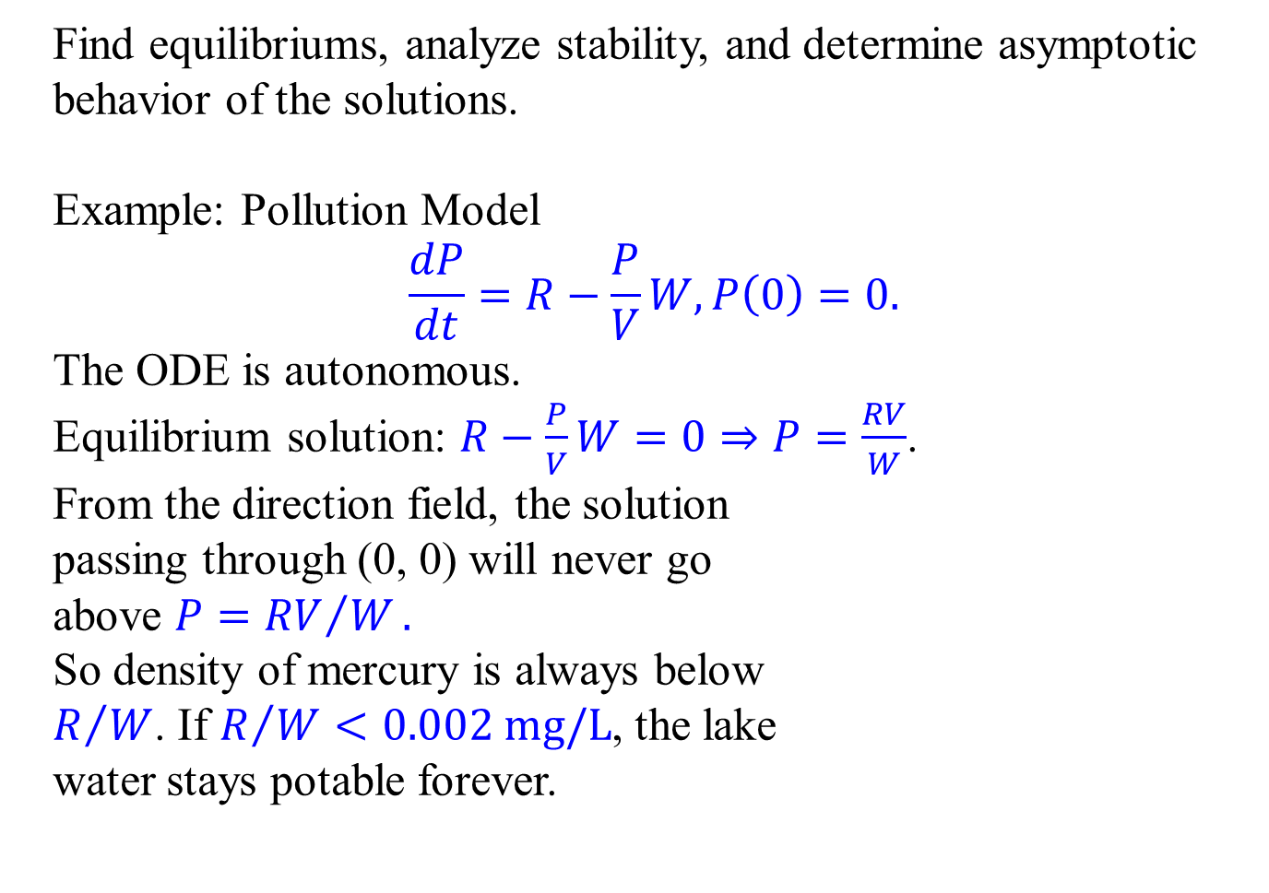

Qualitative method for an autonomous ODE
Find equilibriums, analyze stability, and determine asymptotic behavior of the solutions.
Example: Pollution Model
$$\frac{dP}{dt}=R−\frac{P}{V}W, P\left(0\right)=0.$$
The ODE is autonomous.
Equilibrium solution: $R−\frac{P}{V}W=0⇒P=\frac{RV}{W}$.
From the direction field, the solution
passing through (0, 0) will never go
above $P={RV}/W.$
So density of mercury is always below $R/W$. If $R/W<0.002 mg/L$, the lake water stays potable forever.
$\frac{RV}{W}$

Slide 15

Qualitative method for an autonomous ODE
Find equilibriums, analyze stability, and determine asymptotic behavior of the solutions.
Example: Falling object from great height, subject to gravity $mg$ and the air resistant $−kv^{2}.$ From Newton’s second law:
$$m\frac{dv}{dt}=mg−kv^{2}, v\left(0\right)=0.$$
The ODE is autonomous. Equilibrium solution $mg−kv^{2}=0⇒v=\sqrt{\frac{mg}{k}}$
The equilibrium solution is indeed the terminal velocity.

Slide 16

Qualitative method for an autonomous ODE
Find equilibriums, analyze stability, and determine asymptotic behavior of the solutions.
Example: Falling object from great height:
$$m\frac{dv}{dt}=mg−kv^{2}, v\left(0\right)=0.$$
Equilibrium solution $v=\sqrt{\frac{mg}{k}}$
We may also solve the IVP by separating the variables:
$$\frac{mdv}{mg−kv^{2}}=dt⇒\frac{m}{2\sqrt{mg}}\left(\frac{dv}{\sqrt{mg}−\sqrt{k}v}+\frac{dv}{\sqrt{mg}+\sqrt{k}v}\right)=dt \\ ⇒\frac{1}{2}\sqrt{\frac{m}{kg}}\ln\left|\frac{\sqrt{mg}+\sqrt{k}v}{\sqrt{mg}−\sqrt{k}v}\right|=t+C⇒\frac{\sqrt{mg}+\sqrt{k}v}{\sqrt{mg}−\sqrt{k}v}=Ce^{\frac{2\sqrt{kg}}{m}t}$$

Slide 17
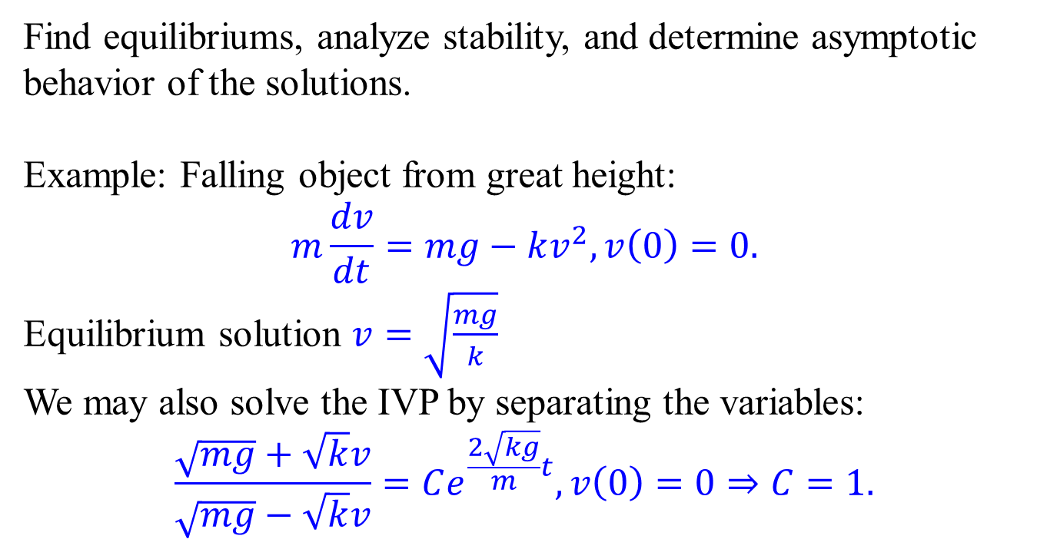
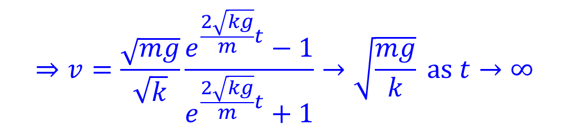
Qualitative method for an autonomous ODE
Find equilibriums, analyze stability, and determine asymptotic behavior of the solutions.
Example: Falling object from great height:
$$m\frac{dv}{dt}=mg−kv^{2}, v\left(0\right)=0.$$
Equilibrium solution $v=\sqrt{\frac{mg}{k}}$
We may also solve the IVP by separating the variables:
$$\frac{\sqrt{mg}+\sqrt{k}v}{\sqrt{mg}−\sqrt{k}v}=Ce^{\frac{2\sqrt{kg}}{m}t},v\left(0\right)=0⇒C=1.$$
$$⇒v=\frac{\sqrt{mg}}{\sqrt{k}}\frac{e^{\frac{2\sqrt{kg}}{m}t}−1}{e^{\frac{2\sqrt{kg}}{m}t}+1}→\sqrt{\frac{mg}{k}} as t→∞$$

